Slide 1
Tries
Tries
Notes:
Tries

Slide 2
A trie is a compact data structure for representing a set of strings, such as all the words in a text
  A tries supports pattern matching queries in time proportional to the pattern size
Tries

Slide 3
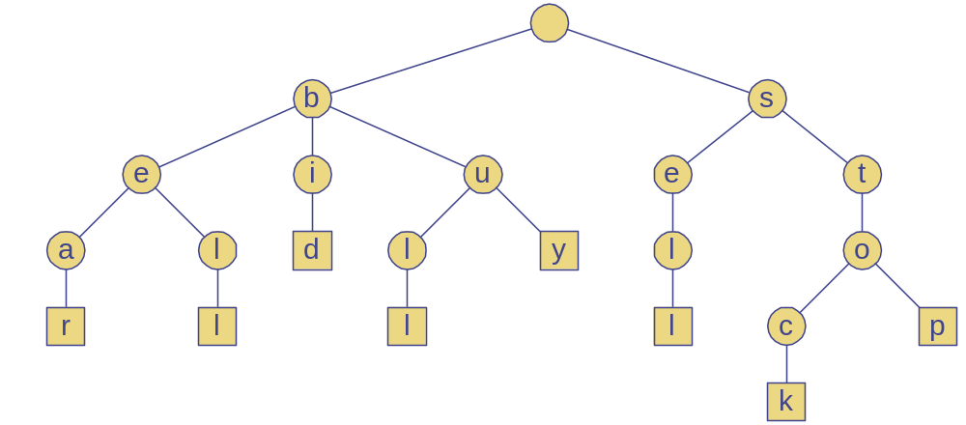
Standard Tries
The standard trie for a set of strings S is an ordered tree such that:
  Each node except the root is labeled with a character
  The children of a node are alphabetically ordered
  The paths from the external nodes to the root yield the strings of S
Example: standard trie for the set of strings
  S = { bear, bell, bid, bull, buy, sell, stock, stop }
Tries

Slide 4
Analysis of Standard Tries
A standard trie uses O(n) space and supports searches, insertions and deletions in time O(dm), where:
  n total size of the strings in S
  m size of the string parameter of the operation
  d size of the alphabet
Tries

Slide 5
Word Matching with a Trie
insert the words of the text into trie
Each leaf is associated w/ one particular word
leaf stores indices where associated word begins (“see” starts at index 0 & 24, leaf for “see” stores those indices)
s
e
e
a
b
e
a
r
?
s
e
l
l
s
t
o
c
k
!
0
1
2
3
4
5
6
7
8
9
10
11
12
13
14
15
16
17
18
19
20
21
22
23
s
e
e
a
b
u
l
l
?
b
u
y
s
t
o
c
k
!
24
25
26
27
28
29
30
31
32
33
34
35
36
37
38
39
40
41
42
43
44
45
46
b
i
d
s
t
o
c
k
!
b
i
d
s
t
o
c
k
!
47
48
49
50
51
52
53
54
55
56
57
58
59
60
61
62
63
64
65
66
67
68
h
e
a
r
t
h
e
b
e
l
l
?
s
t
o
p
!
69
70
71
72
73
74
75
76
77
78
79
80
81
82
83
84
85
86
87
88
b
h
s
e
i
u
e
e
t
a
l
d
l
y
a
e
l
o
47, 58
36
0, 24
r
l
l
r
l
c
p
6
78
30
69
12
84
k
Tries
17, 40,
51, 62

Slide 6
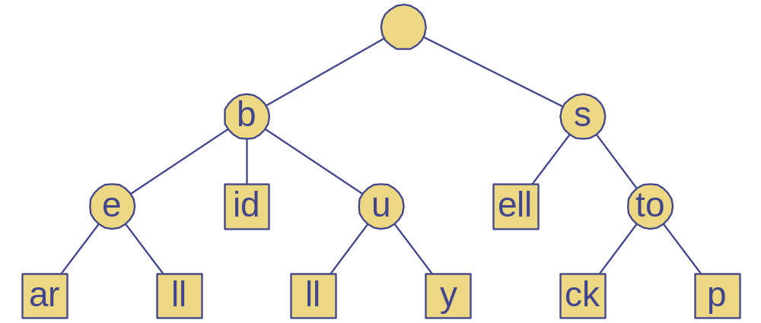
Compressed Tries
A compressed trie has internal nodes of degree at least two
It is obtained from standard trie by compressing chains of “redundant” nodes
ex. the “i” and “d” in “bid” are “redundant” because they signify the same word
Tries

Slide 7
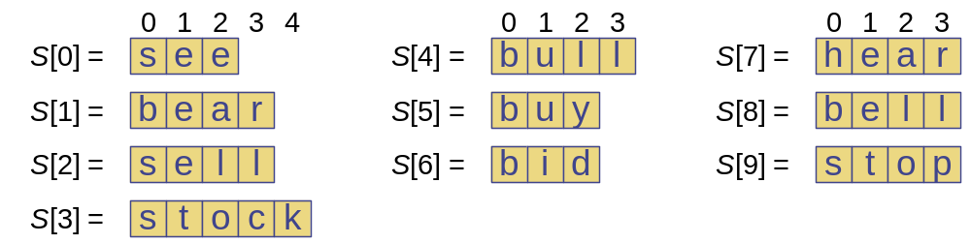
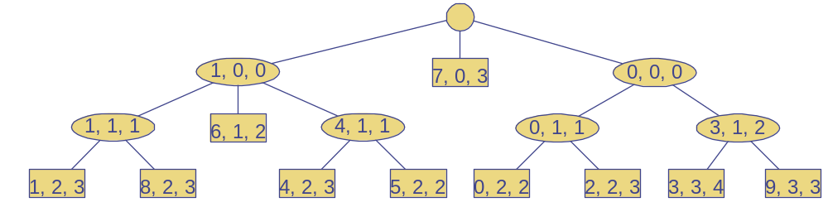
Compact Representation
Compact representation of a compressed trie for an array of strings:
  Stores at the nodes ranges of indices instead of substrings
  Uses O(s) space, where s is the number of strings in the array
  Serves as an auxiliary index structure
Tries

Slide 8
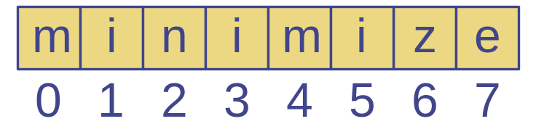
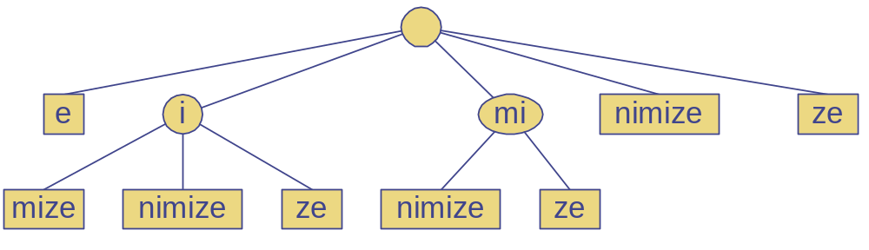
Suffix Trie
The suffix trie of a string X is the compressed trie of all the suffixes of X
Tries

Slide 9
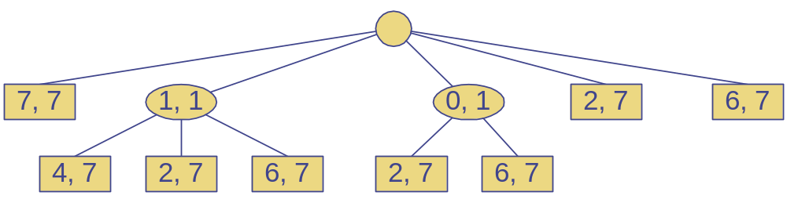
Analysis of Suffix Tries
Compact representation of the suffix trie for a string X of size n from an alphabet of size d
  Uses O(n) space
  Supports arbitrary pattern matching queries in X in O(dm) time, where m is the size of the pattern
  Can be constructed in O(n) time
Tries

